Slide 1
Infrastructure
Infrastructure
to support current and future success
% of tract within 800 m of highway (high % could indicate more favorable)
Existing job density (if past trends predict the future)
Economic Values
Resilience
Equity
Resilience
Tract avg. sov/transit skim vs regional avg. (higher travel times could signal a need for investment)
Tract avg. area of conc. poverty/disparity
Tract job sector richness/evenness (higher richness/diversity = more buffered)
and shared prosperity
throughout our region
in the face of
change and uncertainty
Equity
Tract avg. commute length (higher travel times could signal a need for investment; could consider transit vs sov skims)
Tract avg. ACP/ACA (could indicate need for investment)
Tract avg. educational attainment vs regional (could indicate opportunity to match industries with workers)

Slide 2
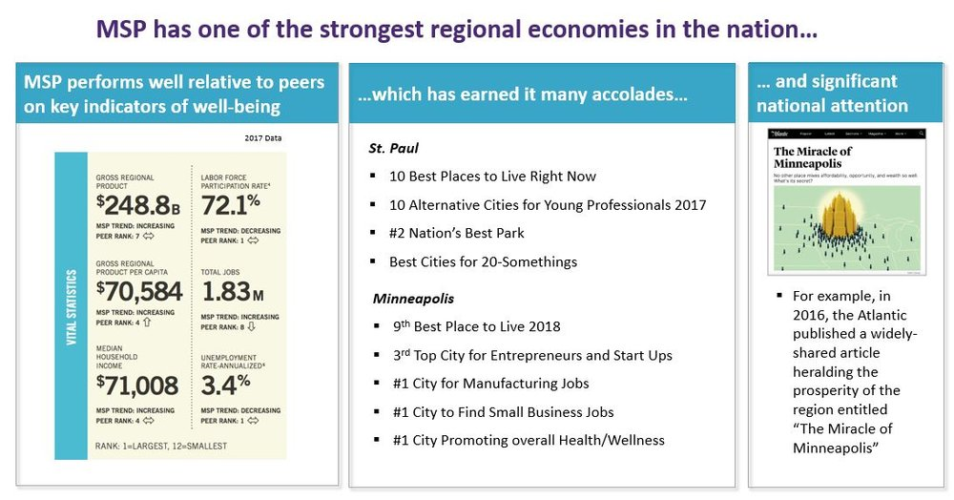
Strong regional economy relative to peers
Strong regional economy relative to peers

Slide 3
EVA tool can intervene and create a shared language for shared economic development and recovery
Goal: trajectory of accelerated and synergistic economic growth alongside COVID-19 recovery
Strong regional prosperity
Regional Prosperity
Juxtaposed against growing racial inequities
Time

Slide 4
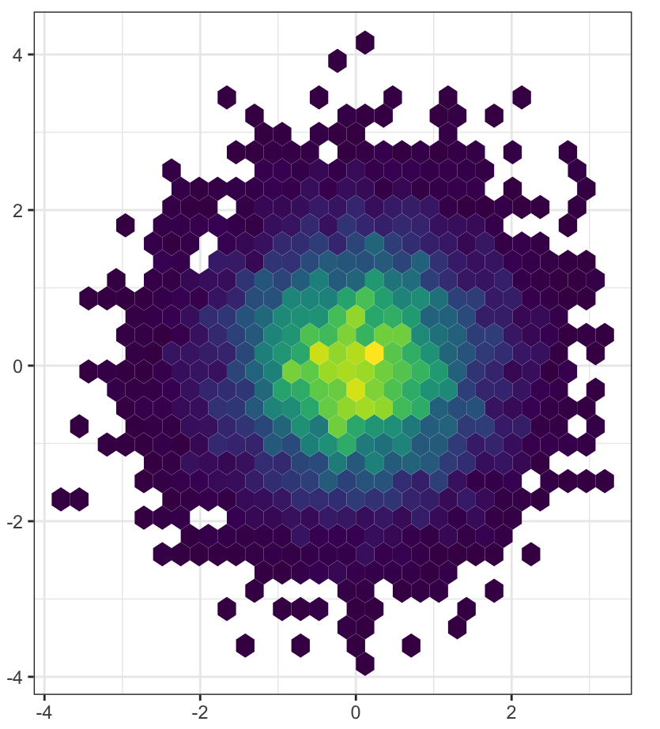
Problem statement + background: How can agreed-upon goals (Thrive2040 and predecessors) have led to such divergent outcomes for economic prosperity in our region? Developing and leveraging an “economic values atlas” with a shared language for economic development is one proposed intervention. EVA can bring an objective lens to project evaluation and decision-making processes that guide regional economic investments, re-investments, and development.
Disruption: COVID-19 and police brutality punctuates the need for a “new normal” and rethinking indicators of regional prosperity
EVA Tool: Synthesize existing yet disparate data sources to produce new insights. Find “opportunity zones” where investments can have disproportionately positive impacts
MAP
Recovery: Create a trajectory of accelerated and synergistic economic growth alongside COVID-19 recovery by developing and leveraging a shared language for economic development
Regional baseline: A strong regional economy masks the phenomena of systemic inequities leading to divergent economic outcomes

Slide 5
Bar Graph = Regional tract avg. vs Selected tract avg (all as z-scores?)
Tabular data → download?
PCA = with selected variables (likely a button render thing)
MAP with layers on/off which correspond to variables included in sidebar
Overlays like transit, parks, musa layers, schools, etc
Reference layers (transit, arterials, parks)
Planning (musa)
Community assests (schools, hospitals,

Slide 6
Twin Cities Economic Values
Shared prosperity (equity)
Sustainable infrastructure that supports economic success
Economic resilience in the face of change (post-pandemic recovery, buffering future tech/industry/retail changes)
-Demo that shiny is a good tool
-use national data sources first, then get into regional specifications/refinements
-describe benefit of eva for planning folks

